Slide 1
IOS App Screenshots

Slide 2


Slide 3
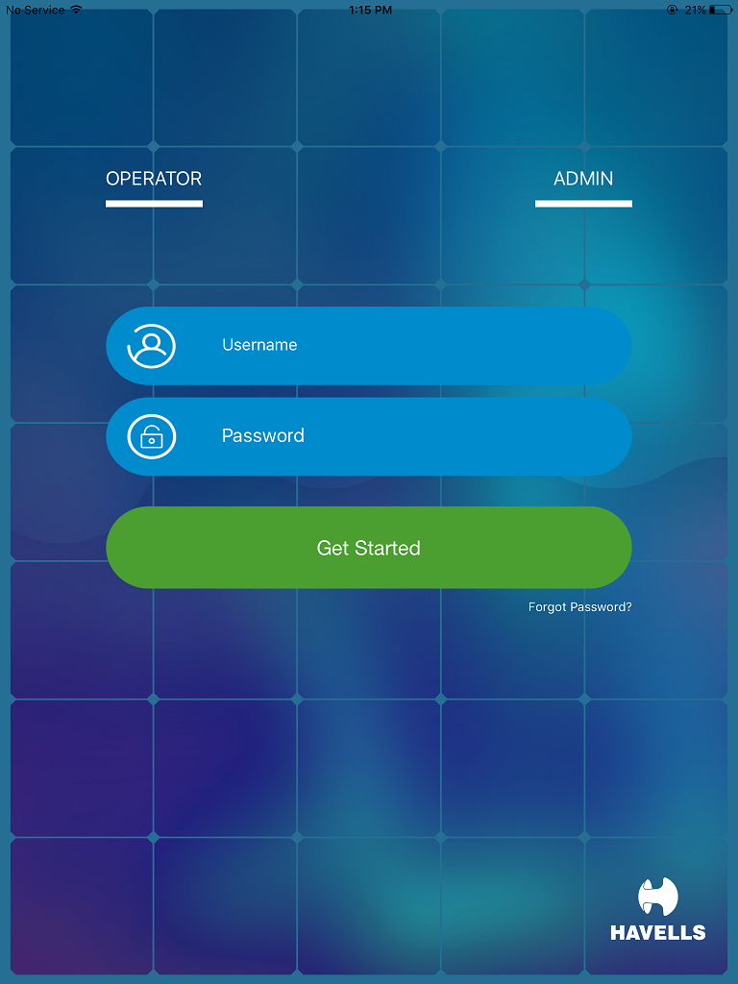
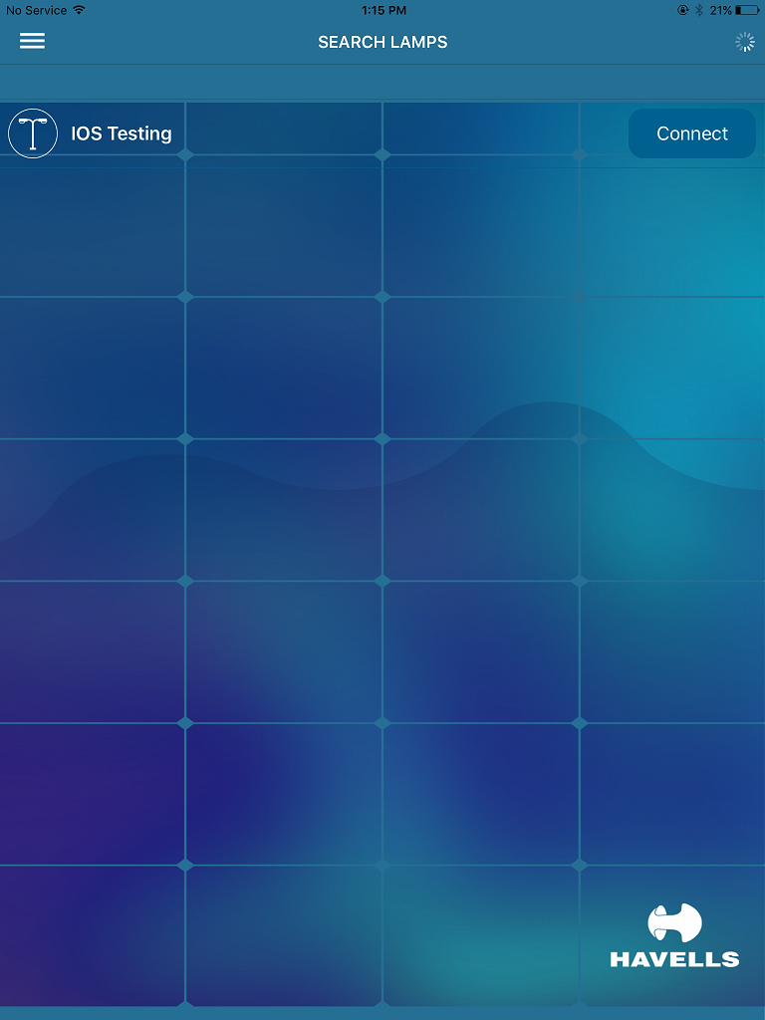
Tap here
Tap here
Login Page
BLE SSL Search list down

Slide 4
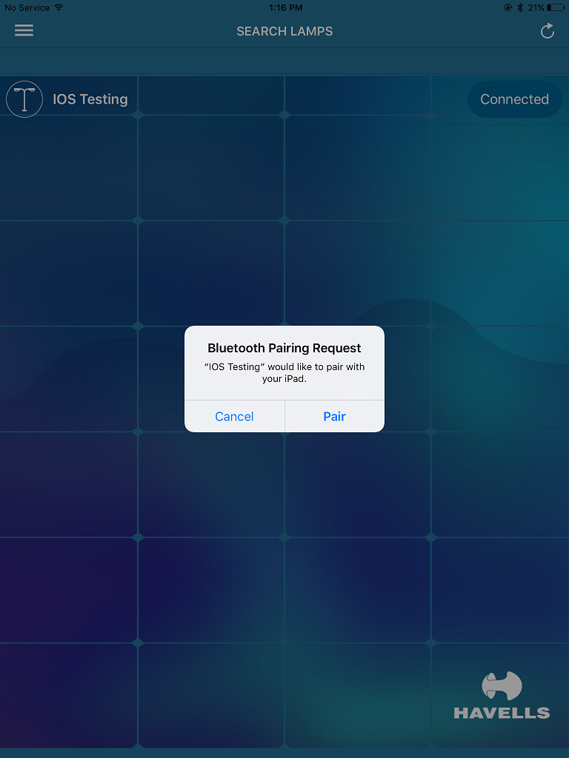
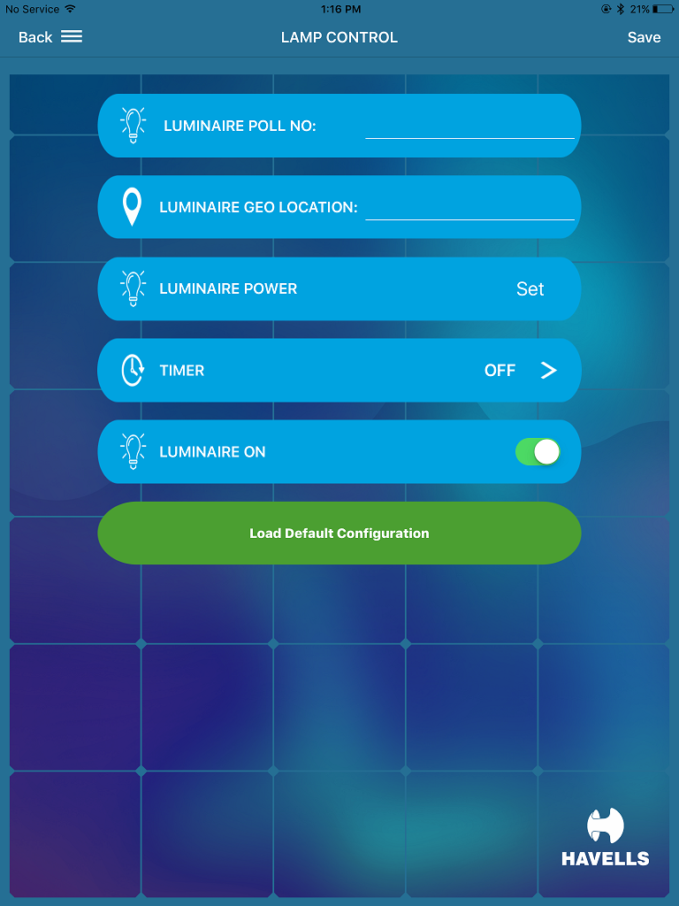
Existing App
Pole No. to be given manually
Location to be given manually
2nd Tap here
Tap here to enter Wattage setting page
Tap here to enter Dimming/ Timer setting page
Identification On/Off control
Default Configuration setting for loading same setting at multiple Street Lights
1st Tap here
Connected
Lamp Configuration

Slide 5
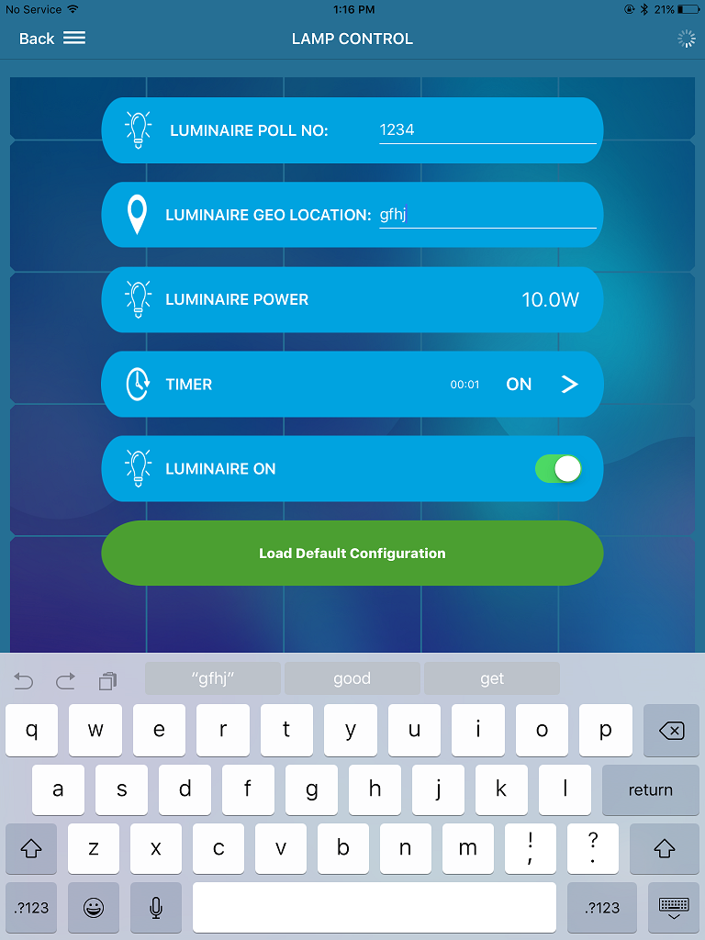
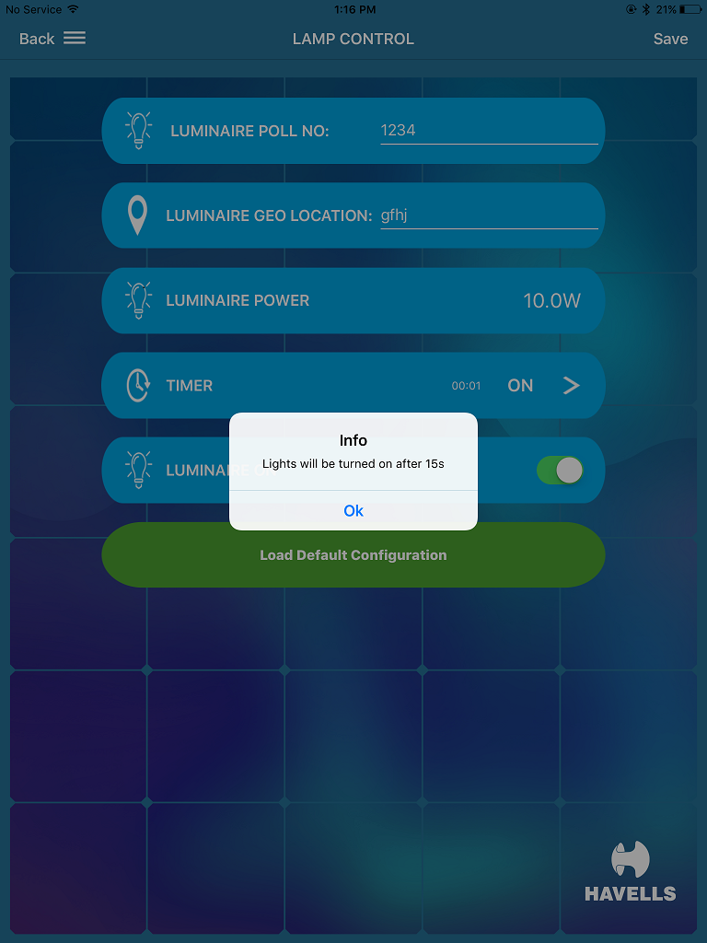
Identification On/Off control to identify connected Street light
Entering Configuration
On/Off control Identification

Slide 6
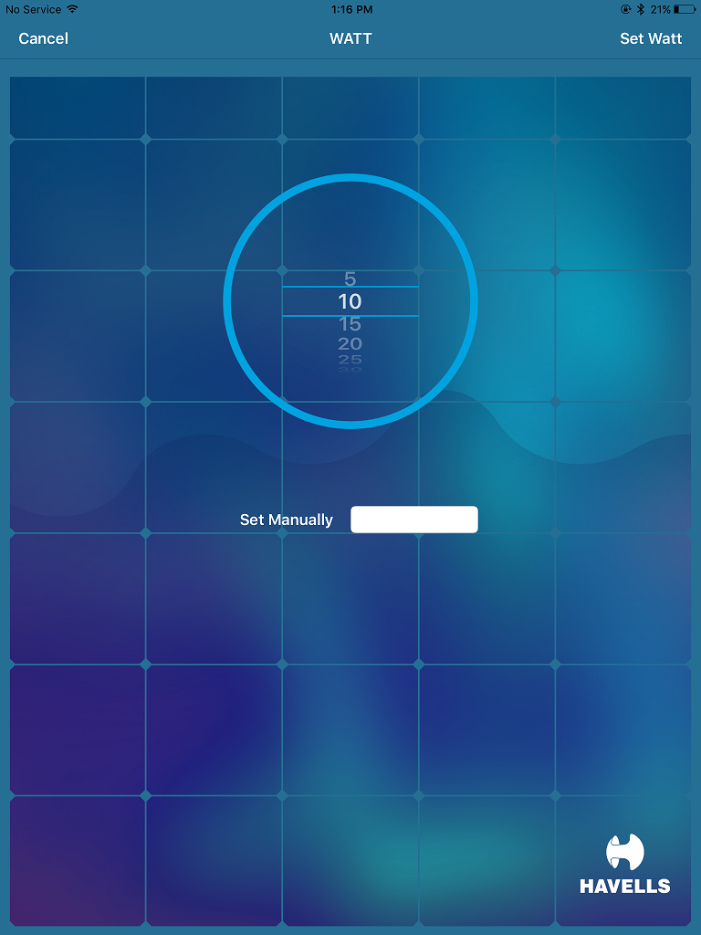
Tap here to enter Wattage setting page
Predefined wattage can be scrolled
Manually also wattage can be set
Configuration Setting
Wattage Setting

Slide 7
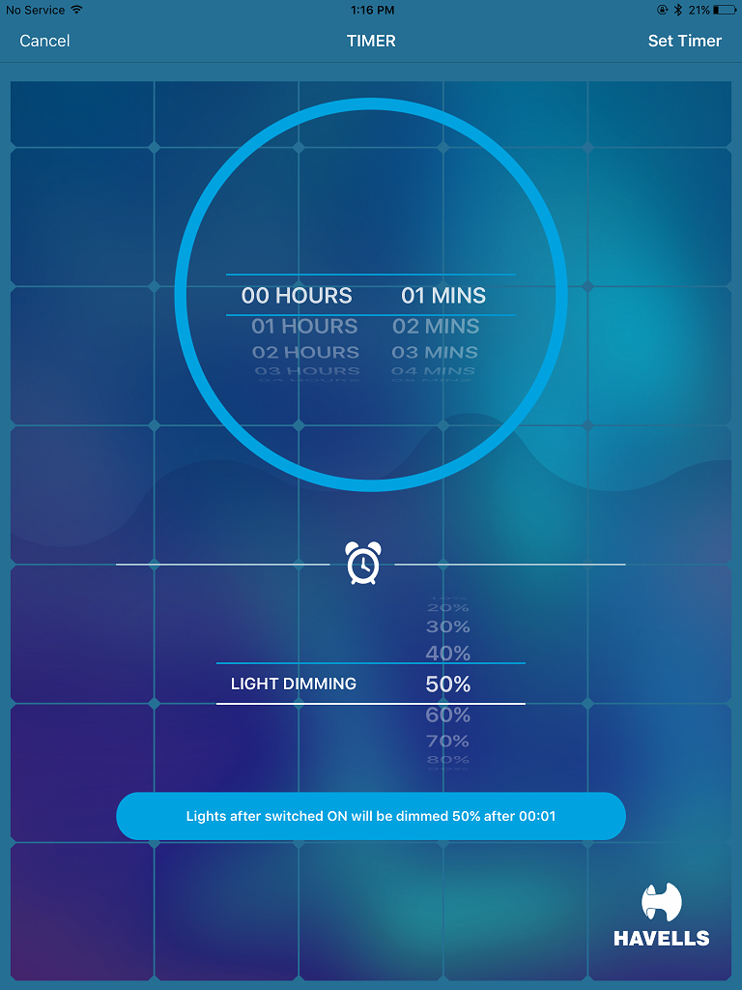
Predefined Timer duration settings can be scrolled
Tap here to enter Dimming/ Timer setting page
Predefined Dimming percentages settings can be scrolled
Configuration Setting
Dimming/Timer Setting

Slide 8
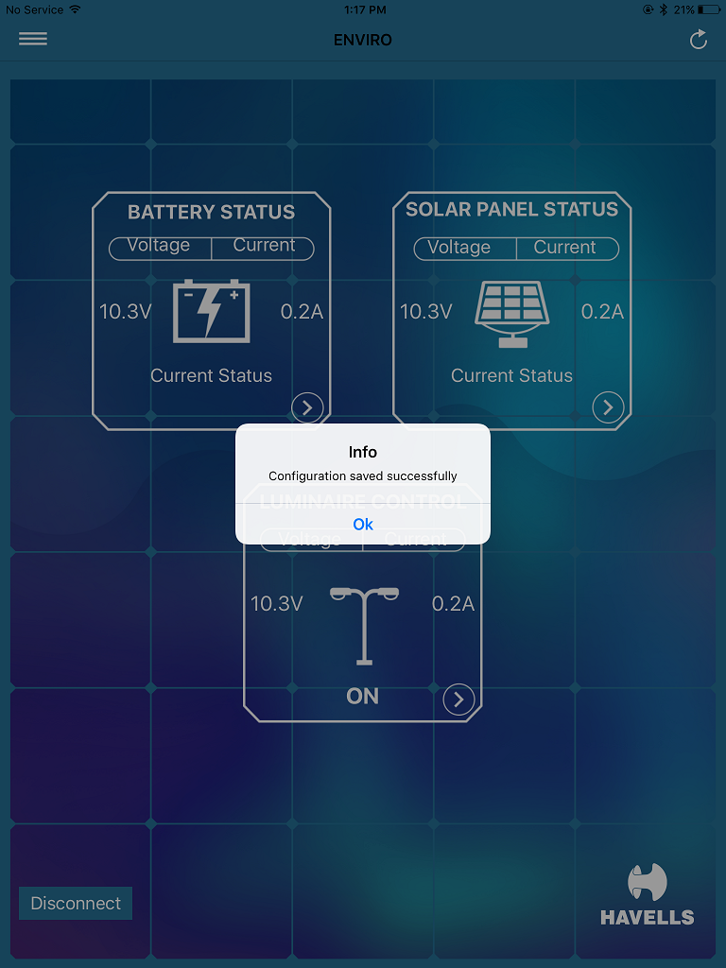
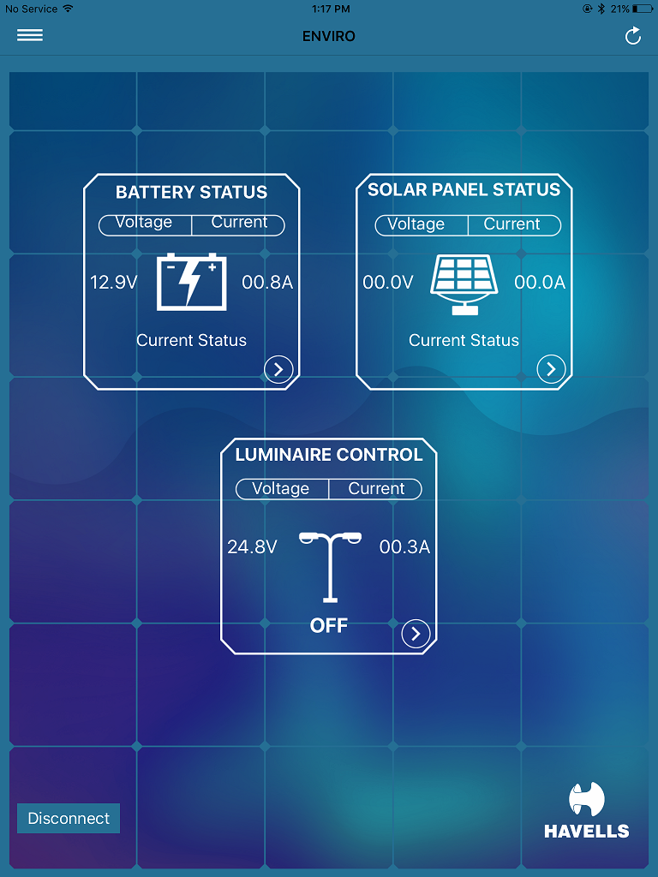
Battery
parameters
Solar
Parameters
Pop-up comes after all parameters are set & configuration is saved completely
Load parameters
Configuration Saved
Street Light Parameters

Slide 9

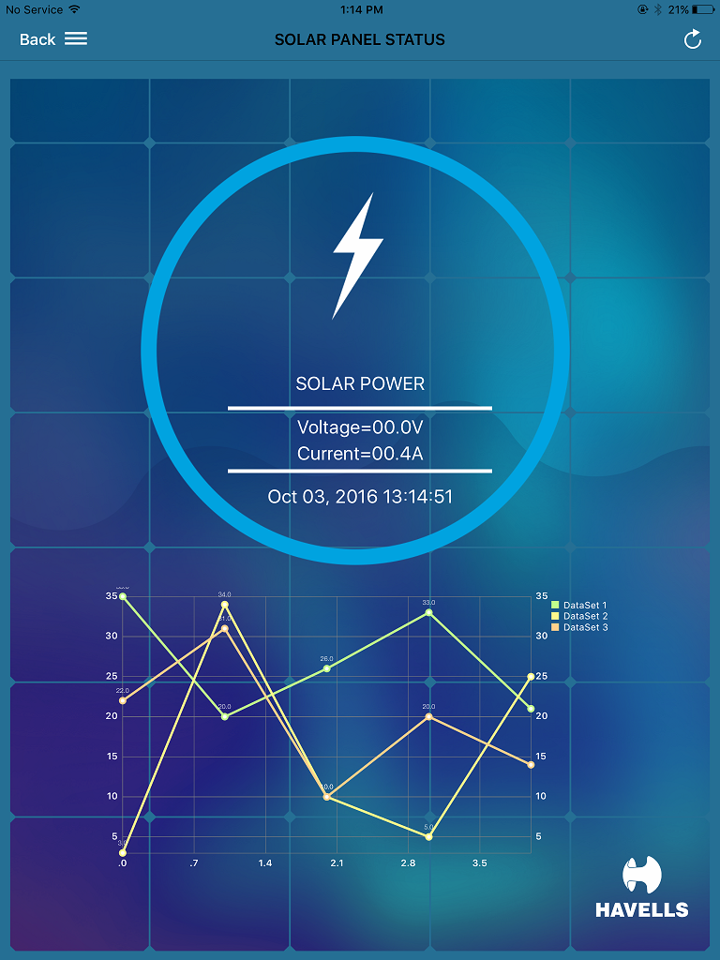
Tap here
To enter Solar
Parameters Page
Total Wh Discharge vs Wh Charged for last 3 days
Street Light Parameters
Solar Parameters

Slide 10
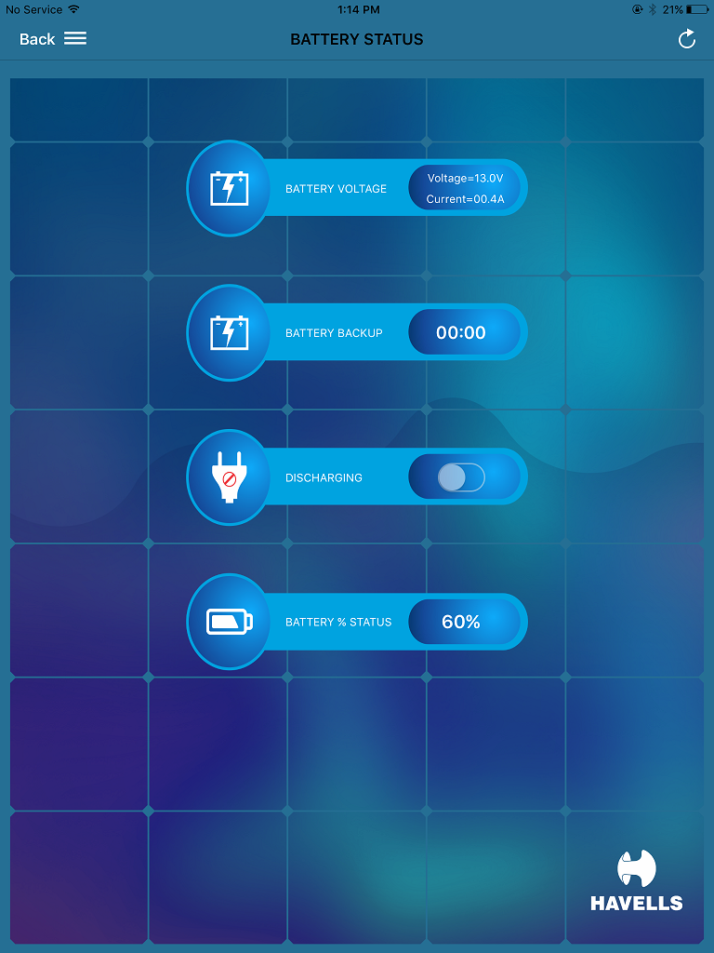
Tap here
To enter Battery
Parameters Page
Street Light Parameters
Battery Parameters

Slide 11
Modification Suggested
in
Enviro Smart App

Slide 12
Modification Required in App
To be changed to “Load Default Configuration” instead of “save”
Pole No. to be given manually
Geo location to be used with GPS
Location to be given manually
2nd Tap here
Tap here to enter Wattage setting page
Modifications
Tap here to enter Dimming/ Timer setting page
Identification On/Off control
To be changed to “Save” instead of “Load Default Configuration”
Default Configuration setting for loading same setting at multiple Street Lights
1st Tap here
Connected
Lamp Configuration

Slide 13
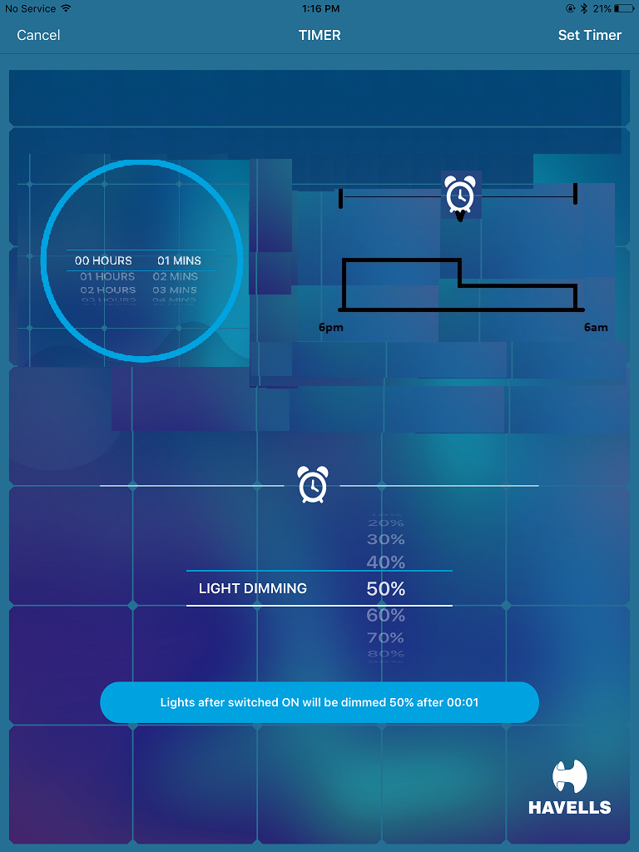
Modification Required in App
Timer Dial to be changed to slide adjustment for Duration adjustment
Slider Adjustment
6Hrs
6Hrs
Full Bright 100%
Predefined Timer duration settings can be adjusted
Dimming 50% after 6hrs
Tap here to enter Dimming/ Timer setting page
Predefined Dimming percentages settings can be scrolled
Configuration Setting
Dimming/Timer Setting

Slide 14
Modification Required in App
To be removed from all pages
Toggle switch to be removed for Charging or discharging mode
Street Light Parameters
Battery Parameters

Slide 15
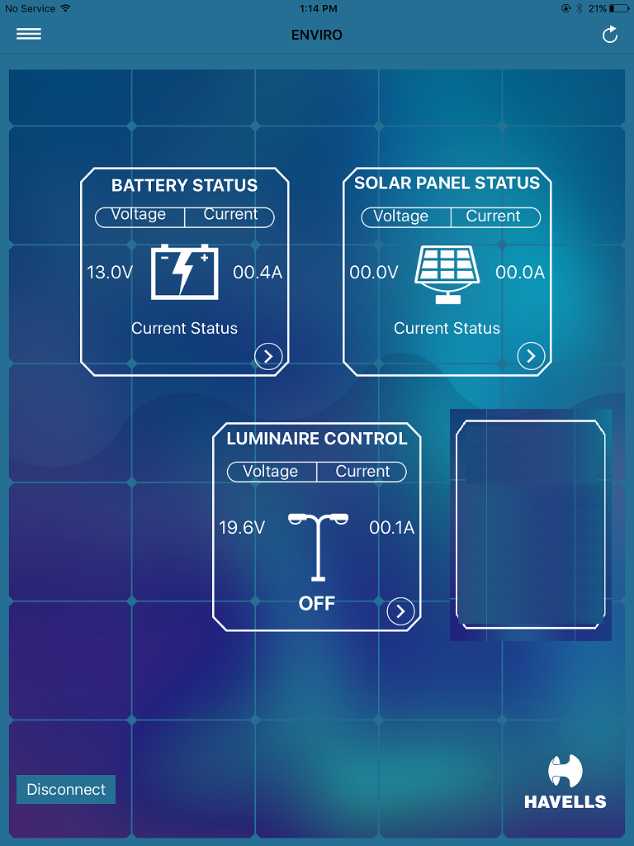
Modification Required in App
CONFIGURATION
Pole No. :
1234
Location :
Peenya
Wattage :
12W
Dimming :
50% after
6hrs
To be moved to top left corner
Configuration Details to be Added
Street Light Parameters
Street Light Parameters

